Slide 1


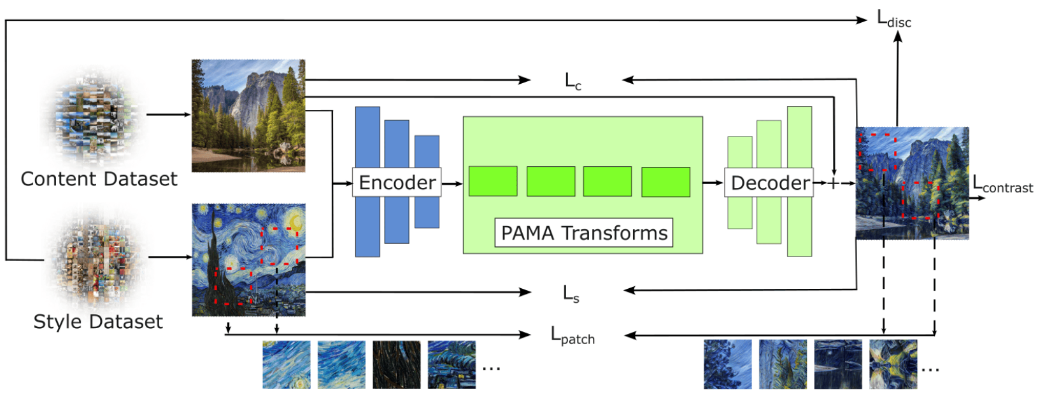
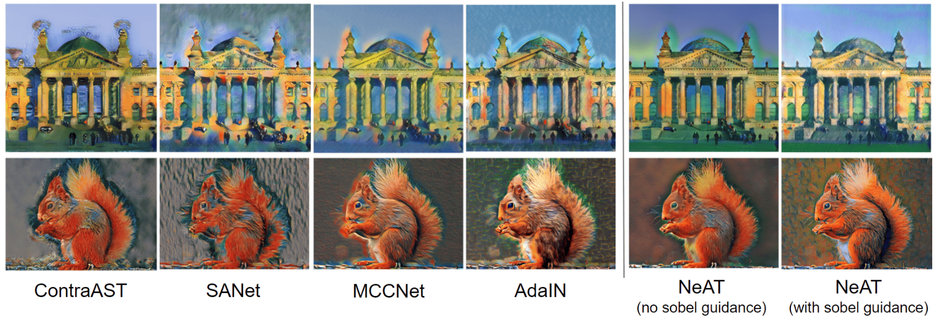
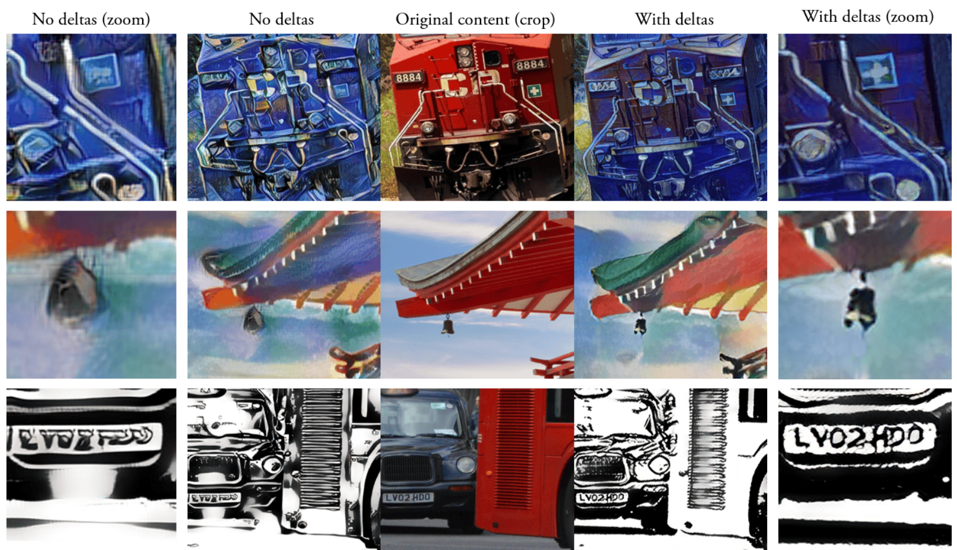
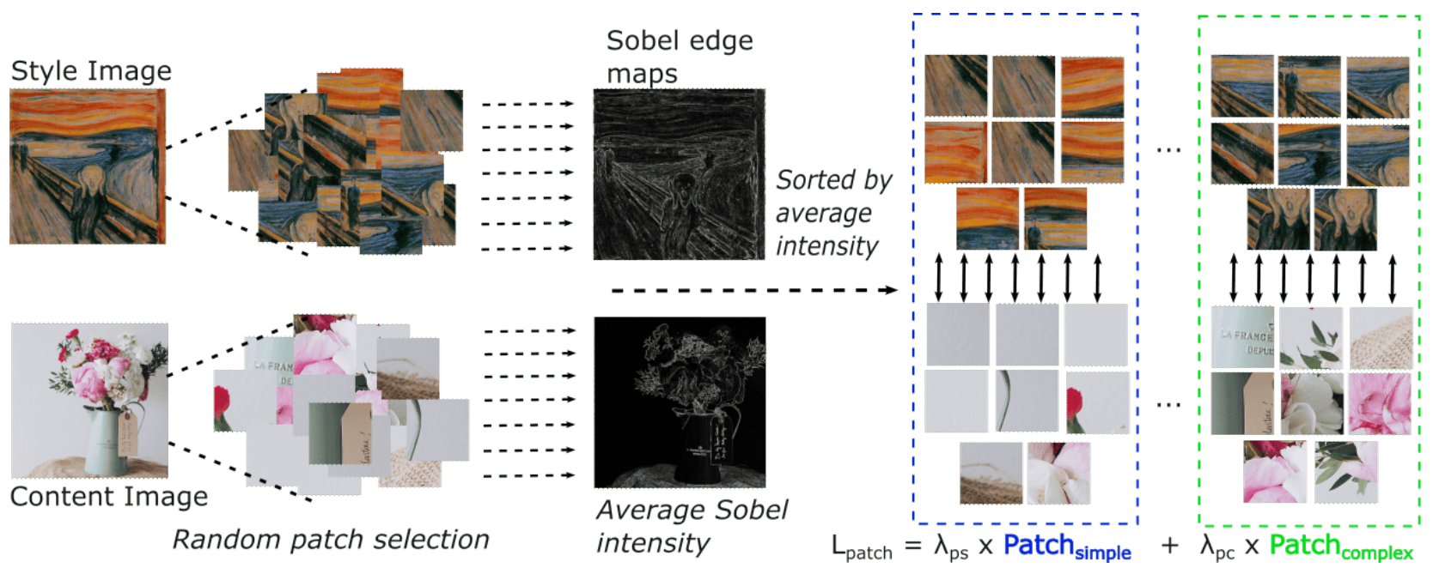
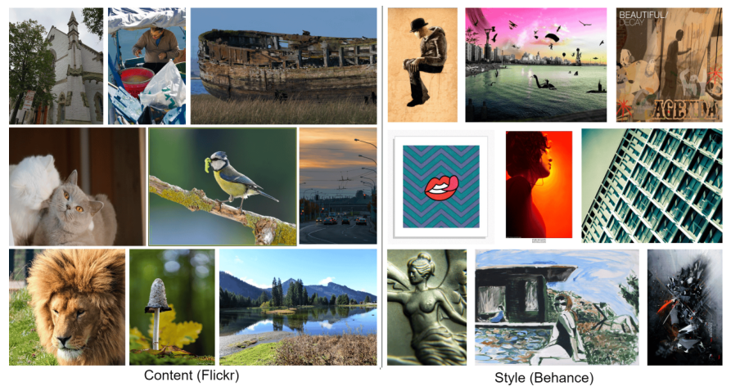
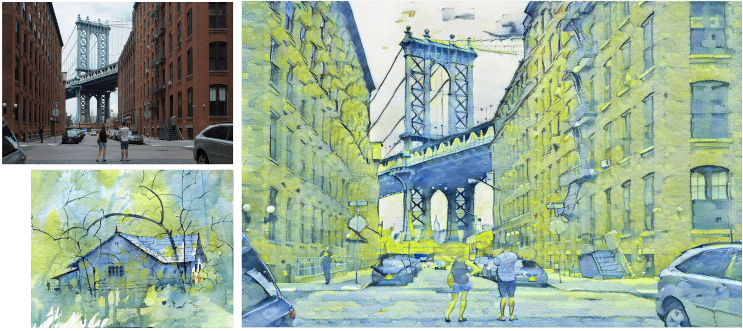
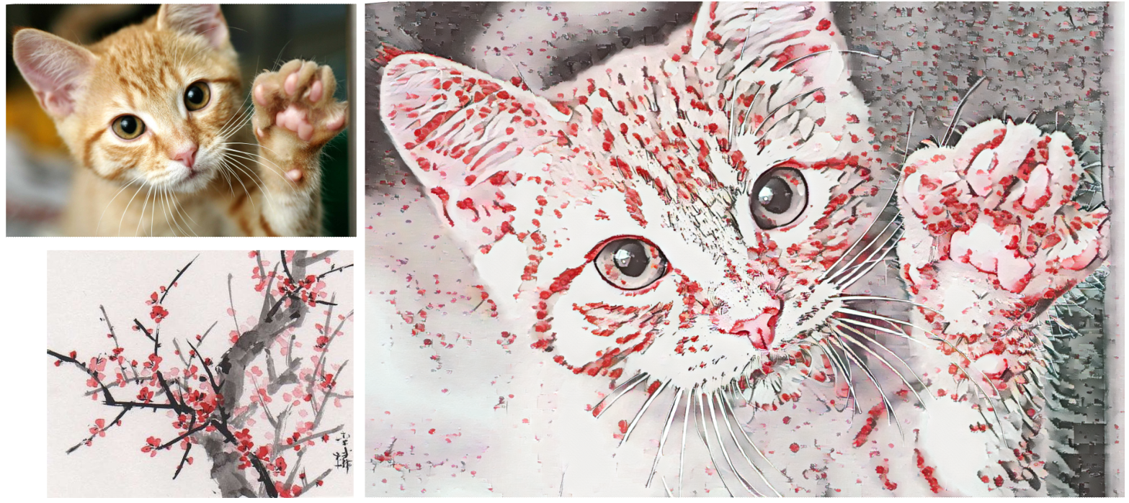
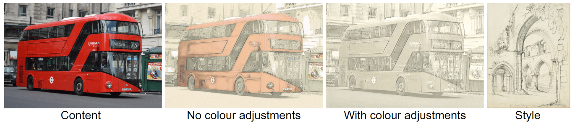
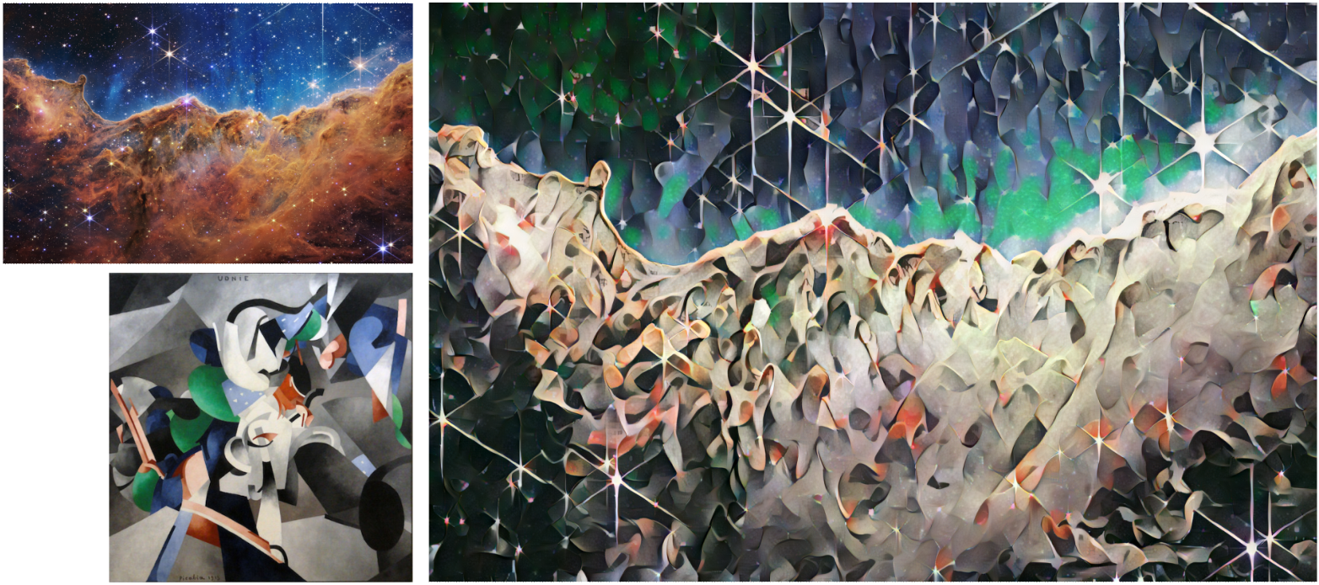
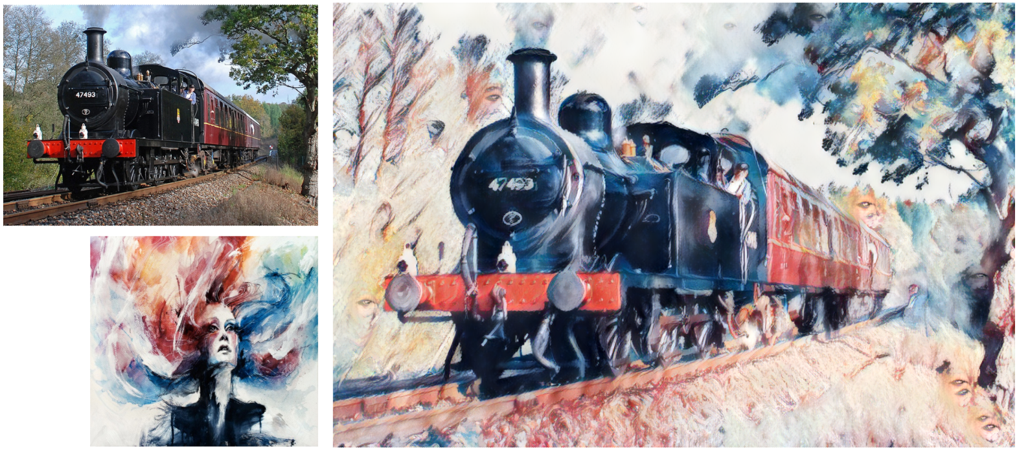
NeAT: Neural Artistic Tracing for high resolution Style Transfer ¹Dan Ruta, ¹Andrew Gilbert, ^{1,2}John Collomosse, ²Eli Shechtman, ²Nicholas Kolkin ¹CVSSP University of Surrey, ²Adobe Research
Background:
We set out to create a Neural Style Transfer (NST) method for high resolution style transfer, maintaining maximum content structure and details.
We re-formulate feed-forward style transfer as image editing, rather than image generation, resulting in a model which improves over the state-of-the-art in both preserving the source content and matching the target style.
We introduce the BBST-4M dataset, a new, large scale, high resolution dataset of 4M images. As a component of curating this data, we present a novel model able to classify if an image is stylistic. We use BBST-4M to improve and measure the generalization
Contribution #1 - BBST-4M Dataset:
4M high resolution image dataset
2M content images
2M style images
Content images collected from Flickr
Style images collected from Behance.net
Images filtered with a stylistic prediction model
Trained over a manually labelled subset of the StyleBabel dataset
The model can predict if an image is artistic, or not
All images are at least 1024px on the smallest side
Training with BBST-4M leads to higher generalization
56% preference of NeAT trained on BBST-4M vs WikiArt+MSCoco, on fine-art styles similar to WikiArt
60% preference of NeAT trained on BBST-4M vs WikiArt+MSCoco, on contemporary digital art
Contribution #3 - Sobel-guided patch co-occurrence discriminator loss for removing style halos:
In our training objective, we include a patch co-occurrence loss
We make novel changes to this, to guide its patch selection in a non-random way
We match patches of simple style texture from the style image with patches of simple texture in the content image
Simple areas such as the background sky should have a simple style texture, whereas a complex texture such as a face should have complex style details
Contribution #2 - NeAT style transfer model:
We train the model to predict pixel deltas over the original content image, instead of re-generating all the content image details from scratch
We avoid the lossy encoding-decoding process, and focus our model only on learning the stylistic changes required
We maintain far more content details in our output, when using deltas
We use additional colour adjustments on the content image, to avoid strong colours skewing the resulting image
Reformulation of NST as an image editing process through use of the original image as residual
Examples of style halos appearing around the edges of complex textures against simple textures

